Slide 1
Multi-Class Classifier of Accents for Audio Utterances in Spanish
Prepared By: Ricardo Zambrano

Slide 2
Motivation
Resolving Semantic Ambiguity
May help improve the performance of speech activated systems working in the Spanish language
Improving available technologies in the Spanish Language. Embeddings are an example:
“¿Qué tal la marcha en Venezuela?”
“How good is the party scene in Venezuela?”
“How is the protest in Venezuela?”
Glove
Vectors trained in U. Chile
Notes:
Paper said Word2Vec embeddings work just fine. This word was not in the vocabulary

Slide 3
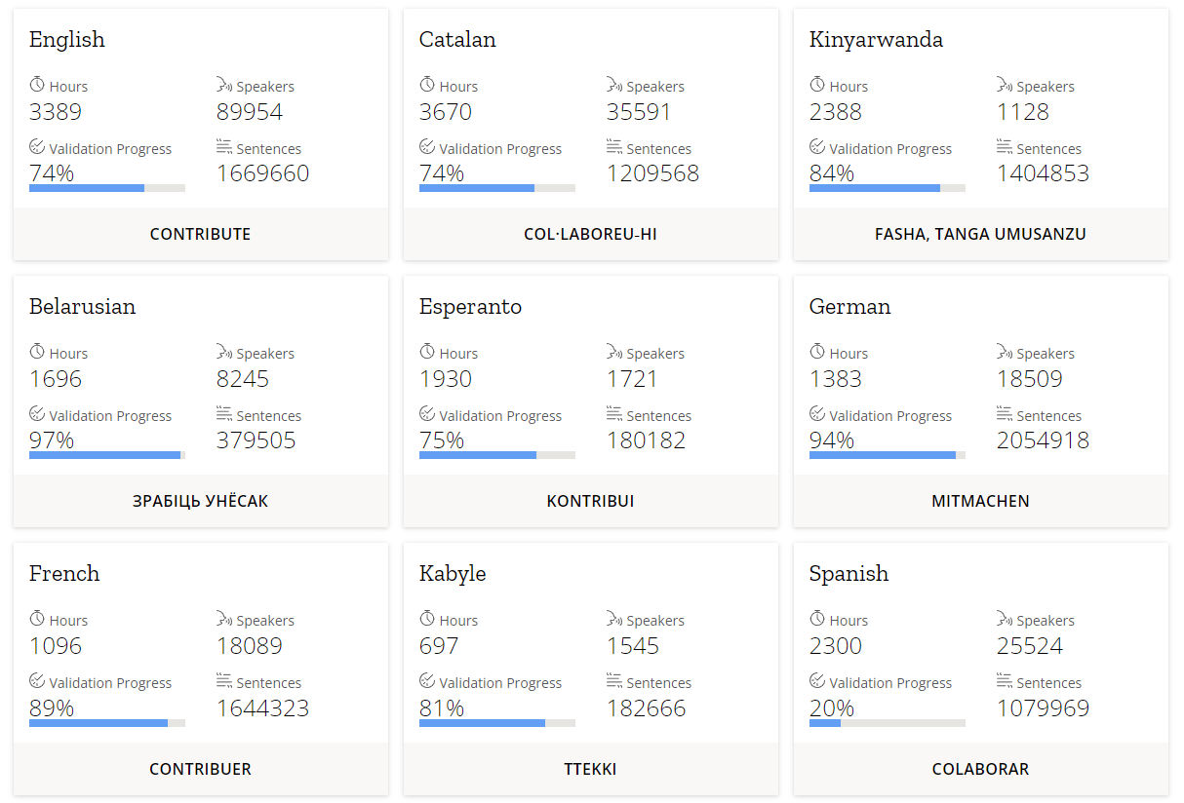
Dataset: Common Voice
Common Voice is a crowdsourcing project started by Mozilla to create a free database for speech recognition software.
The project is supported by volunteers who:
record sample sentences with a microphone, and
review recordings of other users (votes lead to quality categories)

Slide 4
Dataset: Common Voice
Extracting the tar.gz file in the Volume (connected to an AWS-S3 bucket) was taking more than 48 hours [48.5 GB]
Decision: Interrupting the extraction and work with the number of audio records extracted to far leaving [765,000] files down from about 1.4 million mp3 recordings (in the same timeframe about 1.2 million mp3 files were extracted in personal computer)
Likewise, checking if files were available in the Volume took far longer compared with what it took checking in local folder tree

Slide 5
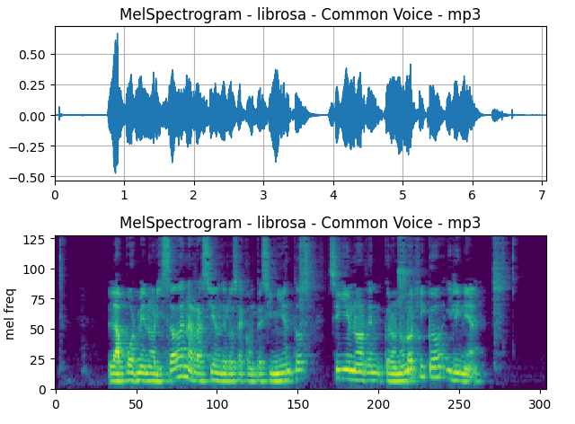
Audio Processing
Librosa (no need for dependencies for mp3 format) or Torchaudio
Mel Spectrogram:
Visual representation of the spectrum of frequencies of a signal as it varies with time
FFT Algorithm
Uses Mel scale on y-axis and Decibel scale instead of Amplitude in color-axis

Slide 6
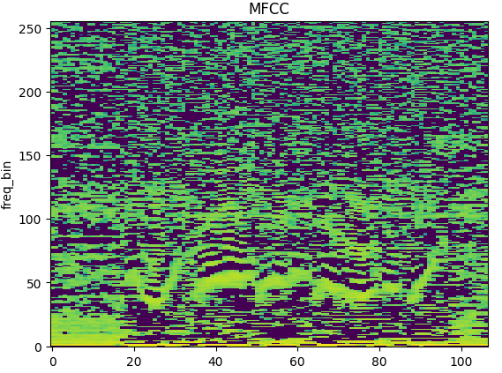
Audio Processing
Mel-frequency cepstral coefficients (MFCC):
Coefficients that collectively make up an MFC
Mel-frequency cepstrum (MFC) is a representation of the short-term power spectrum of a sound, based on a linear cosine transform of a log power spectrum on a nonlinear mel scale of frequency
MFCCs are a set of coefficients that capture the shape of the power spectrum of a sound signal
Notes:
MFCC is to compress information about the vocal tract (smoothed spectrum) into a small number of coefficients based on an understanding of the cochlea.
Take the Fourier transform of (a windowed excerpt of) a signal.
Map the powers of the spectrum obtained above onto the mel scale, using triangular overlapping windows or alternatively, cosine overlapping windows.
Take the logs of the powers at each of the mel frequencies.
Take the discrete cosine transform of the list of mel log powers, as if it were a signal.
The MFCCs are the amplitudes of the resulting spectrum.

Slide 7
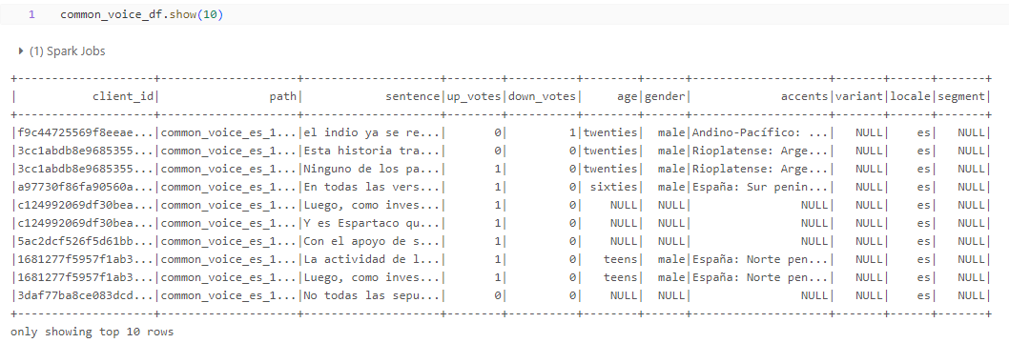
Load, Cleaning, and Encoding
Loaded the ‘other.tsv’ dataset [1,150,345]
Notes:
Validated.tsv, invalidated.tsv, reported.tsv

Slide 8
Load, Cleaning, and Encoding
Removed rows with Null/NA values in the ‘sentence’ and ‘accents’ columns
Original dataset had 111 distinct accents. There were duplicates, in the form of different names for the same accent
After re-mapping different accent names to a unique value, 29 distinct accents were present in the dataset
Common Voice categories are not granular enough: ‘Rolo’ and ‘Cachaco’ are two different accents within the Colombian accents. They are both confounded in ‘Andean’
Accents with no information, such as ‘neutral’, were labeled as ‘Discard’ and rows with this value were filtered out

Slide 9
Load, Cleaning, and Encoding
After discarding rows with labels lacking information; 932,533 were left
Decision:
Low efficiency of the complex UDF for audio pre-processing, and
File loading speed of the Volume (connected to an S3 bucket),
A subset of the records would have to be selected:
A ‘random’ sample of 40% was selected, leaving 373,087 utterings
From these; 105,996 had a matching mp3 file in the Volume
For the records in the final dataset, the ‘accents’ column was encoded into integers using an ‘encoding dictionary’ and a simple UDF

Slide 10
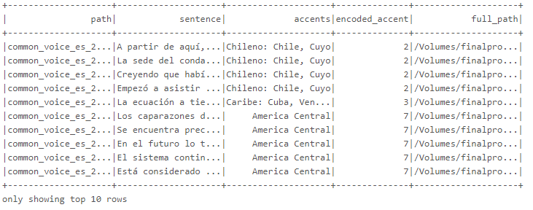
Load, Cleaning, and Encoding
At this point the dataframe was saved to disk to avoid the lazy evaluation of every step while extracting the MFCC features and later when training the model

Slide 11
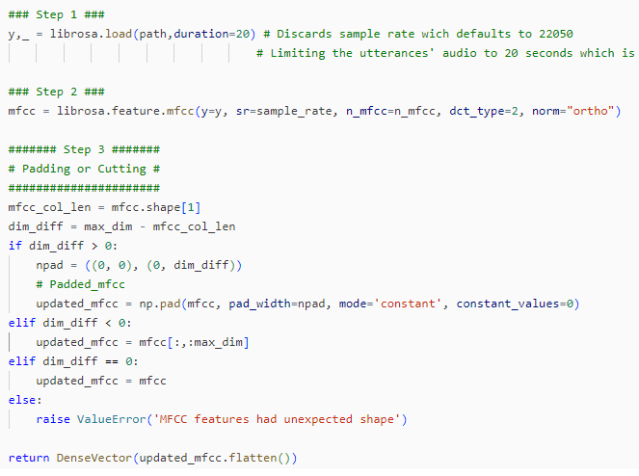
Audio Pre-Processing: UDF
PySpark dataframe does not support numpy data types
PySpark dataframe columns passed to an UDF are Pandas.Series data type inside the scope of the UDF
On shot to load audio waveform, extract MFCC features, and pad output
Return Dense Vector data type
Notes:
Tried a struct first.

Slide 12
Audio Pre-Processing: UDF
The UDF needs to be registered
The algorithm terminated execution on DataBricks. It did not on local device

Slide 13
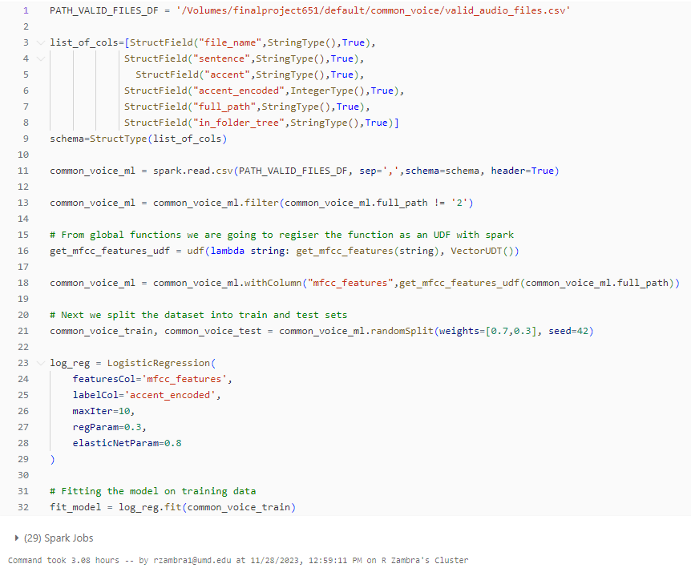
Model: Multinomial Logistic Regression
All steps in one go to avoid evaluation of the dataframe

Slide 14
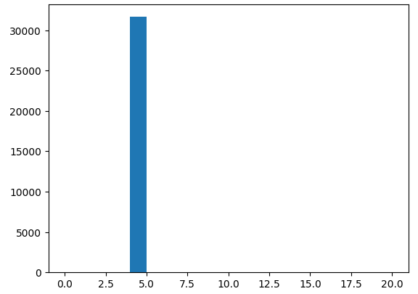
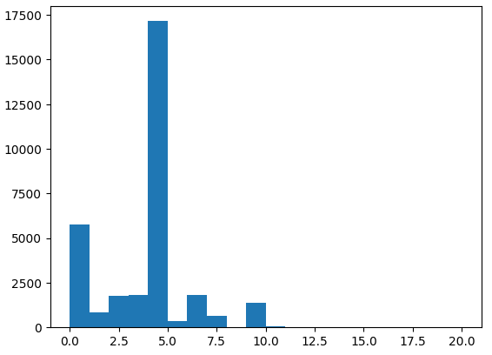
Model: Evaluation
Prediction
Training Accuracy: 0.54
Test Accuracy: 0.54
Causes:
Predicts majority class
Imbalanced dataset
In smaller dataset (not requiring
Sampling) accuracy was higher
True Value

Slide 15
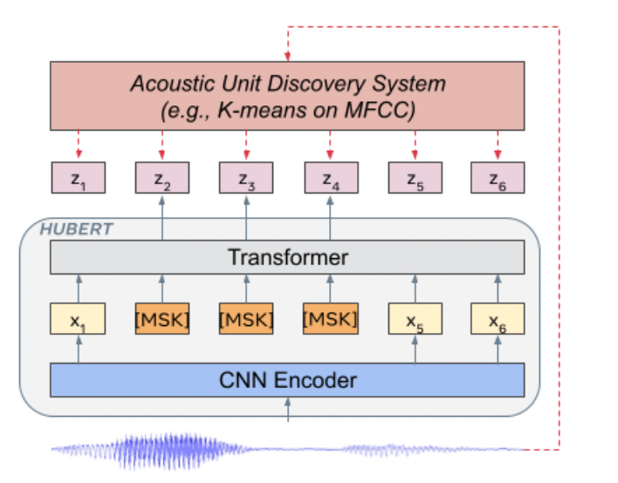
Future Work and Conclusions
Logistic Regression was not a good model for the accents classification task
Limitation of available models, as well as the compatibility limitation of numpy data type, forced some hard choices (i.e. flateing the MFCC features) that proved not conducive to a good-performing model
Training a model using the HuBERT architecture and Torch Distributor
Requires a big data tool that supports numpy, a data type foundational for working with audio

